Slide 1


Steam Games Recommender System
Koh Si Ting

Slide 2
INTRODUCTION
ANALYSIS
RECOMMENDER SYSTEM
CONCLUSION
Tools | Methodology | Dataset
Top 10 Games (Users) | Top 10 Games (Hours)
Collaborative Filtering (ALS) | Evaluation
Insights
Notes:
This is my agenda for my presentation. Start off with introduction, analysis, my recommender system then end off with conclusion.

Slide 3

Notes:
So some of you might wonder What is Steam Steam is one of the biggest video game digital service available in the market right now, with millions active users and accounts, hosting over thousands of computer games, which makes it an ideal platform for recommender system to be in place to facilitate consumers in their gaming experience.

Slide 4
Motivation
PS game lover
Let’s explore Steam games!
Notes:
Motivation is very simple, I am actually more of a Playstation, sometimes Nintendo gamer, so I will try some computer games at some point of time, so when this project comes along, it inspires me to create a recommender system to see what games will be recommended to me

Slide 5
Tools
Pandas, Numpy: DataFrame, Transforming data
Matplotlib & Seaborn : Plot graphs
Scipy : Sparse matrix
Implicit, Pyspark, reco_utils : Algorithms for Recommender System
Sckit-learn: Evaluation metrics
Notes:
These are the tools I used for my project, mostly on the libraries on the different algorithms for recommender system

Slide 6
Methodology
Data Cleaning & EDA
Recommender System
Performance & Evaluation
Split columns
Collaborative filtering recommendation (ALS Model ) on Implicit data
RSME
Rename columns
Top 10 Games
Drop duplicates
Spark
Recommendation example
AUC score
Notes:
So for methodology for my project. First start with data cleaning which I will talk about it more later, and EDA on top 10 games. Then I moved on to create my recommender system using collaborative filtering method. Lastly, I evaluate my system and come up with an recommendation example.

Slide 7
Dataset (Original) - Kaggle
user_id | game_title | behavior | value
5250 | Alien Swarm | purchase | 1.0
5250 | Alien Swarm | play | 4.9
5250 | Cities Skylines | purchase | 1.0
5250 | Cities Skylines | play | 144.0
5250 | Counter-Strike | purchase | 1.0
5250 | Counter-Strike Source | purchase | 1.0
200,000 rows | 5,155 unique games | 12,393 unique users
Notes:
This is portion of the dataset I gotten from Kaggle
The dataset contains a total of 200,000 rows
For the behavior, If is ‘play’, the value associated to it corresponds to the amount of hours played. If is ‘purchase’, the value is always 1.
Note that: this data collection essentially duplicates each record, and some games only have purchase and no record of play, which means the gamer only bought the game but no hours played (and this is clearly not captured in the dataset)
Therefore, I will remove the duplicates in the process of splitting the column and keep only the genuine 'play' hours.

Slide 8
Dataset (Cleaned)
user | game | hours | purchase | play
5250 | Alien Swarm | 4.9 | 1 | 1
5250 | Cities Skylines | 144.0 | 1 | 1
5250 | Counter-Strike | 0.0 | 1 | 0
5250 | Counter-Strike Source | 0.0 | 1 | 0
5250 | Day of Defeat | 0.0 | 1 | 0
5250 | Deathmatch Classic | 0.0 | 1 | 0
128,804 rows | 5,155 unique games | 12,393 unique users | 128,804 purchases | 70, 477 games played
Notes:
So this is the cleaned dataset.
Each row here now represents a unique interaction between user-game.
Note that, only the records has dropped but the no. of unique games and users stayed the same, which means there is no loss of information or data.

Slide 9
Exploratory Data Analysis (EDA)
Notes:
So now we are good to do some EDA and explore some gaming pattern or habits or preferences

Slide 10
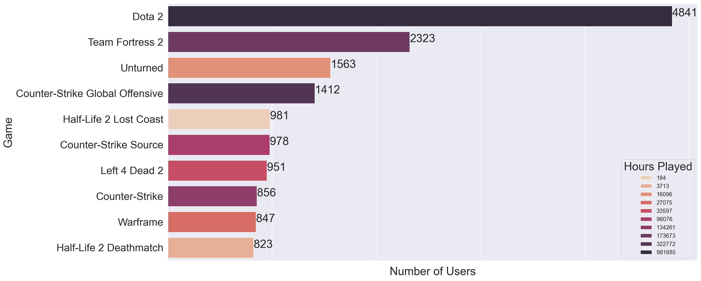
Bar-plot: Top 10 Games (Most no. of Users)
Notes:
This is a Bar-plot on top 10 games based on no. of users.
We can see that for some games, there is a relation between most played and most purchased. For example, ‘Dota 2’ is undeniably the most popular game with most number of users and hours played.
However, this is not always the case, an example is ‘Half-Life 2’ which has a high number of users but pretty low hours played. A possible explanation for this could be that this game was purchased as part of a game bundle. Games like these add noise to the dataset.

Slide 11
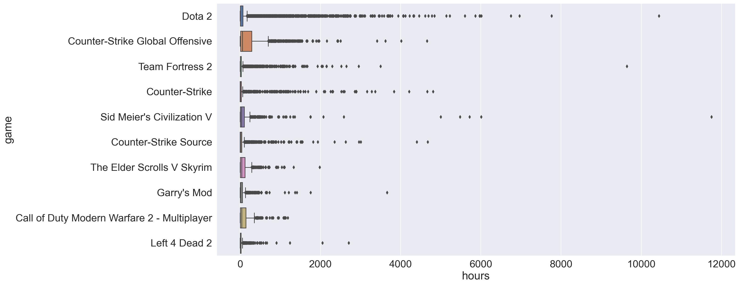
Boxplot: Top 10 Games based on Hours played
Notes:
Next, this is a box plot for the top 10 most played game, based in the total of hours played.
As we can see, 75% of data points for each game is in the range of hundreds of hours, with several games having very large outliers like these 2 fellows right here. They are probably hardcore gamers or professional esports gamers.

Slide 12

Recommender System
Collaborative filtering recommendation
(ALS Model ) on Implicit data
Notes:
So now lets talk about my recommender system using ALS model

Slide 13
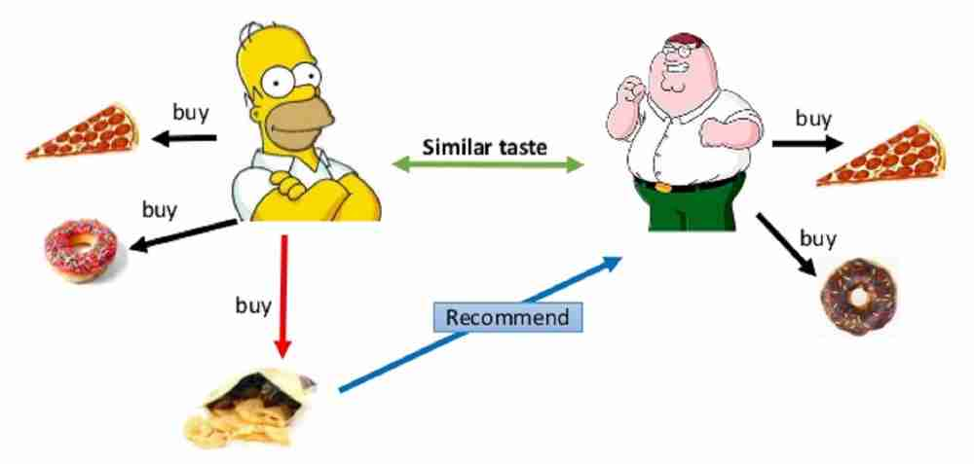
Collaborative Filtering (CF)
A method of making automatic predictions (filtering) about the interests of a user by collecting preferences or taste information from others users (collaborating)
Explicit Data (e.g. Rating) VS Implicit Data (i.e. gaming hours played – what I’m using)
Notes:
Just a quick refresher on what is Collaborative filtering
It is a method of making automatic predictions about the interests of a user by collecting preferences information from other users
It requires either
Explicit data is data where we have some sort of rating,
Implicit data is data we gather from the users behavior. In my model here, it will be the gaming hours.

Slide 14
Algorithms For Implicit Data
Algorithms | Description | Remarks
Alternating Least Squares (ALS) | Matrix factorization algorithm for explicit or implicit feedback in large datasets | Works well
Cornac/Bayesian Personalized Ranking (BPR) | Matrix factorization algorithm for predicting item ranking with implicit feedback | Fails to recommend (very low precision)
Expectation-Maximization (EM Algorithm) | Performs maximum likelihood estimation in the presence of latent variables | - Created rating system based on the distribution of hours played - Not as good as ALS
Simple Algorithm for Recommendation (SAR) | Similarity-based algorithm for implicit feedback dataset | Missing timestamp for training model
Notes:
There are a few algorithms I tried out but due to time constraint, I will only focus on ALS which works well for my recommender system,

Slide 15
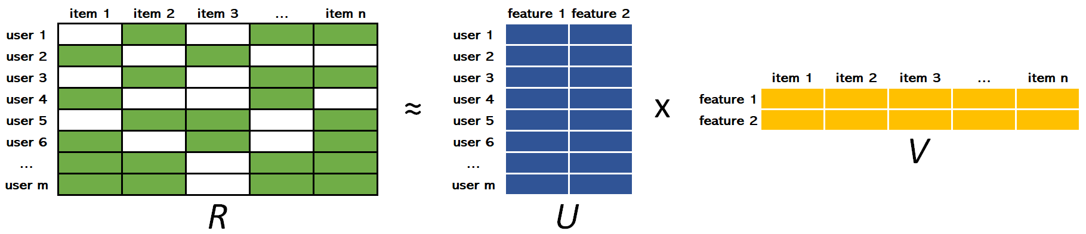
ALS (Implicit Library) Collaborative Filtering for Implicit Feedback Datasets by Hu, Koren and Volinsky
User - Game Interaction Matrix
User Matrix
Game Matrix
Preference for Game (purchased game) +
Confidence for the Preference ( hours played)
Notes:
So for ALS, there is actually an implicit library available to create recommender system, it is noted to be used by Facebook and Spotify
Their method is to merge the preference (p) for an item with the confidence (c) we have for that preference
We fill the users by games matrix with simple preferred which means purchased the game as 1 or 0 which means no interaction between the user and the game.
But recall for my dataset, all purchases are represented by ones, now, what if the users dislike or regret their purchases?
Well, we handle this by adding confidence matrix which is calculated using the magnitude of hours played. Intuitively, it means that the more time a user spent playing the game, we have more confidence in that the user actually liked the game.

Slide 16
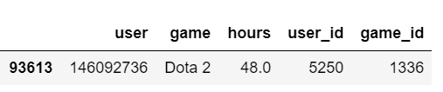
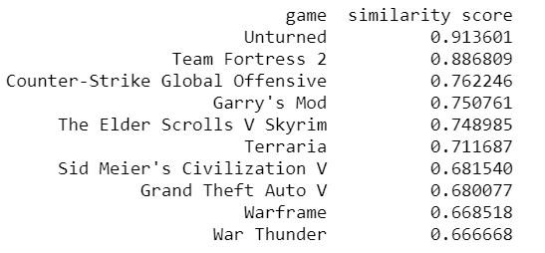
Evaluation & Recommendation
ALS (Implicit)
RMSE | 0.031
AUC Score | 0.848
Notes:
So this is an evaluation of my recommender system and an example on the top 10 recommendations for this user who has purchased dota2. Most of these games seems relevant, as most are all multi-players games like dota2

Slide 17
PySpark – ALS Matrix Factorization Techniques for Recommender Systems by Koren, Bell and Volinsky
Treat data as numbers representing the strength in observations of user actions (gaming hours played)
Can deal with both implicit / explicit data
Deal with Cold start Problem (new users or items that have no preference history)
In-built functions: ParamGridBuilder, CrossValidator, SparkRatingEvaluation
Precision @ k | Recall @ k
0.33 | 0.93
Notes:
Before I move on to conclusion, I actually tried pyspark for ALS. Is similar to Implicit library, but there are added benefits like it deals with explicit data and cold start problem
Beside the evaluation metrics I showed earlier, there is also precision and recall @ k. this is result I have gotten for my recommender system using Spark.

Slide 18

Conclusion

Slide 19
Insights & Future Work
Recommender System is challenging!
Implicit model, unlike Spark, will be hard to recommend games to new users like me
Bottom line : Able to recommend relevant games to user
More data cleaning (DLCs games)
Consider User-Item Bias
Try Content-based Recommender System
Notes:
Recommender system is hard, it takes me a lot of time to understand on how to create and evaluate using implicit data.
Implicit model will be hard to recommend games to new users like me
Bottom line, I would say my system still able to recommend relevant games to users.
Things to do to improve my recommender system includes:
More data cleaning: consolidate games which are like DLCs (add
Look into adding on user and item bias into training my model. Intuitively, I will expect some users play games at a faster pace. Similarly, some games would take less time to complete. Handling this might improve accuracy on how users interact with the games.
Try content-based recommender system
Yup with that, thank you for your attention.

Slide 20


THANK YOU!
sitingkoh1808
sitingkoh1808
Credits:
https://slidesgo.com/
https://spark.apache.org/docs/2.2.0/ml-collaborative-filtering.html
https://implicit.readthedocs.io/en/latest/als.html
https://github.com/microsoft/recommenders
Do you have any questions?
Notes:
. Okay that’s all, Thank you.

